Slide 1


Business
and
Technology

Slide 2
Concept of Business
The word “business” is derived from “busy” which literally means the state of being busy.
Any human activity of production and distribution of goods and services to earn economic gain is business.
Business involves regular and continuous production, purchase and sale of goods and services for the purpose of earning profit by satisfying the customers.

Slide 3
Concept of Business
According to Prof. Richard Norman Ownes, business is “an enterprise engaged in the production of goods for sales in a market or the rendering of services for a price”
Prof. Lewis H. Hancy defined business as “a human activity directed towards producing and acquiring wealth through buying and selling of goods”

Slide 4
Concept of Technology
Technology is a body of knowledge devoted to creating tools, processing actions and extracting of materials. It is an application of science to solve a problem.
It can be described as combination of four factors of production
- Land, labour, capital and knowledge.
Ability to create new things blending of these resources.

Slide 5
Concept of Technology
In terms of organizational point of view,
According to G. Jones and C. Hill, “ Technology is the combination of skills and equipment that managers use in the design, production and distribution of goods and services.
According to R. Bennett, “Technology is the utilization of the materials and processes necessary to transform materials into outputs.”

Slide 6
Forms of Technology
Hard Technology
Soft Technology
Patents
Capital equipment
Designs
Technical specifications
Management
Organization
Administration
Notes:
Textured and layered background
(Intermediate)
To reproduce the first background layer on this slide, do the following:
On the Home tab, in the Slides group, click Layout, and then click Blank.
Also on the Home tab, in the Drawing group, click Shapes, and then under Rectangles, click Rectangle.
On the slide, drag to draw a rectangle.
Select the rectangle. Under Drawing Tools, on the Format tab, in the Shape Styles group, click Shape Fill, point to Gradients, and then click More Gradients. In the Format Shape dialog box, click Fill in the left pane, in the Fill pane, click Gradient fill, and then do the following:
In the Type list, select Linear.
In the Angle box, enter 70°.
Under Gradient stops, click Add gradient stop or Remove gradient stop until four stops appear in the slider.
Also under Gradient stops, customize the gradient stops as follows:
Select the first stop in the slider, and then do the following:
In the Position box, enter 0%.
Click the button next to Color, click More Colors, and then in the Colors dialog box, on the Custom tab, enter values for Red: 19, Green: 52, and Blue: 61.
In the Transparency box, enter 0%.
Select the next stop in the slider, and then do the following:
In the Position box, enter 37%.
Click the button next to Color, click More Colors, and then in the Colors dialog box, on the Custom tab, enter values for Red: 75, Green: 172, and Blue: 198.
In the Transparency box, enter 0%.
Select the next stop in the slider, and then do the following:
In the Position box, enter 73%.
Click the button next to Color, click More Colors, and then in the Colors dialog box, on the Custom tab, enter values for Red: 49, Green: 133, and Blue: 156.
In the Transparency box, enter 0%.
Select the last stop in the slider, and then do the following:
In the Position box, enter 100%.
Click the button next to Color, click More Colors, and then in the Colors dialog box, on the Custom tab, enter values for Red: 75, Green: 172, and Blue: 198.
In the Transparency box, enter 0%.
Also in the Format Shape dialog box, click Line Color in the left pane, in the Line Color pane, select No line.
Also in the Format Shape dialog box, click Size in the left pane, in the Size pane, under Size and rotate, enter 7.5” in the Height box and 10” in the Width box.
On the Home tab, in the Drawing group, click Arrange, point to Align, and then do the following:
Click Align to Slide.
Click Align Middle.
Click Align Center.
To reproduce the second background layer on this slide, do the following:
On the Home tab, in the Drawing group, click Shapes, and then under Rectangles click Rectangle.
On the slide, drag to draw a rectangle.
Select the rectangle. Under Drawing Tools, on the Format tab, in the Shape Styles group, click the Format Shape dialog box launcher. In the Format Shape dialog box, click Fill in the left pane, in the Fill pane, select Picture or texture fill, and then do the following:
Click the button next to Texture and then click Brown Marble (third row).
Clear the “Tile picture as texture” check box.
Under Stretch options, in the Transparency box, enter 80%.
Also in the Format Picture dialog box, click Line Color in the left pane, in the Line Color pane, select No line.
Also in the Format Picture dialog box, click Picture Corrections in the left pane, in the Picture Corrections pane, under Brightness and Contrast, enter 12% in the Brightness box and 44% in the Contrast box.
Also in the Format Picture dialog box, click Picture Color in the left pane, in the Picture Color pane, under Recolor, click the button next to Presets, and then click Grayscale (first row).
Also in the Format Picture dialog box, click Artistic Effects in the left pane, in the Artistic Effects pane, click the button next to Artistic Effect, click Glow Diffused (second row), and then do the following:
In the Transparency box, enter 47%.
In the Intensity box, enter 9.
Also in the Format Picture dialog box, click Size in the left pane, in the Size pane, under Size and rotate, enter 7.5” in the Height box and 10” in the Width box.
On the Home tab, in the Drawing group, click Arrange, point to Align, and then do the following:
Click Align to Slide.
Click Align Middle.
Click Align Center.
To reproduce the third background layer on this slide, do the following:
On the Home tab, in the Drawing group, click Shapes, and then under Rectangles click Rectangle.
On the slide, drag to draw a rectangle.
Select the rectangle. Under Drawing Tools, on the Format tab, in the Shape Styles group, click the Format Shape dialog box launcher. In the Format Shape dialog box, click Fill in the left pane, in the Fill pane, select Picture or texture fill, and then do the following:
Click the button next to Texture and then click Granite (third row).
Select the “Tile picture as texture” check box.
Under Tiling options, in the Transparency box, enter 95%.
Also in the Format Picture dialog box, click Line Color in the left pane, in the Line Color pane, select No line.
Also in the Format Picture dialog box, click Picture Corrections in the left pane, in the Picture Corrections pane, under Brightness and Contrast, enter -20% in the Brightness box and 100% in the Contrast box.
Also in the Format Picture dialog box, click Picture Color in the left pane, in the Picture Color pane, under Recolor, click the button next to Presets, and then click Grayscale (first row).
Also in the Format Picture dialog box, click Artistic Effects in the left pane, in the Artistic Effects pane, click the button next to Artistic Effect, click Photocopy (fifth row), and then do the following:
In the Transparency box, enter 30%.
In the Intensity box, enter 3.
Also in the Format Picture dialog box, click Size in the left pane, in the Size pane, under Size and rotate, enter 7.5” in the Height box and 10” in the Width box.
On the Home tab, in the Drawing group, click Arrange, point to Align, and then do the following:
Click Align to Slide.
Click Align Middle.
Click Align Center.
To reproduce the fourth background layer on this slide, do the following:
On the Home tab, in the Drawing group, click Shapes, and then under Rectangles, click Rectangle.
On the slide, drag to draw a rectangle.
Select the rectangle. Under Drawing Tools, on the Format tab, in the Shape Styles group, click Shape Fill, point to Gradients, and then click More Gradients. In the Format Shape dialog box, click Fill in the left pane, in the Fill pane, click Gradient fill, and then do the following:
In the Type list, select Radial.
In the Direction list, select From Center.
Under Gradient stops, click Add gradient stop or Remove gradient stop until two stops appear in the slider.
Also under Gradient stops, customize the gradient stops as follows:
Select the first stop in the slider, and then do the following:
In the Position box, enter 0%.
Click the button next to Color, under Theme Colors, click Black, Text 1 (first row).
In the Transparency box, enter 100%.
Select the last stop in the slider, and then do the following:
In the Position box, enter 100%.
Click the button next to Color, click More Colors, and then in the Colors dialog box, on the Custom tab, enter values for Red: 36, Green: 25, and Blue: 15.
In the Transparency box, enter 50%.
Also in the Format Shape dialog box, click Line Color in the left pane, in the Line Color pane, select No line.
Also in the Format Shape dialog box, click Size in the left pane, in the Size pane, under Size and rotate, enter 7.5” in the Height box and 10” in the Width box.
On the Home tab, in the Drawing group, click Arrange, point to Align, and then do the following:
Click Align to Slide.
Click Align Middle.
Click Align Center.

Slide 7
Applications of Technology in Business
Communication
E-commerce
Virtual workplace

Slide 8
Communication
Communication is essential to successful business operations, and the technology of the twenty-first century has become completely integrated in business interaction.
Company networks are faster, the Internet has become a powerful force, and wireless communications have transformed the way business is performed.
Examples are e-mail, video conferencing, cell phones, etc.

Slide 9
E-commerce
E-commerce (electronic commerce or EC) is the buying and selling of goods and services, or the transmitting of funds or data, over an electronic network, primarily the internet.
It operates at four levels:
- Business to Business
- Business to customer
- Customer to Customer
- Customer to Business

Slide 10
E-commerce
The benefits of e-commerce include its around-the-clock availability, the speed of access, the wide availability of goods and services for the consumer, easy accessibility, and international reach.
Its perceived downsides include sometimes-limited customer service, consumers not being able to see or touch a product prior to purchase, and the necessitated wait time for product shipping.

Slide 11
Virtual Workplace
A virtual workplace is a workplace that is not located in any one physical space.
It is usually in a network of several workplaces technologically connected (via a private network or the Internet) without regard to geographic boundaries.

Slide 12
Advantages and Disadvantages of Virtual Workplace
Advantages
Disadvantages
Lower overhead costs
More satisfied employees
Higher scalability
Less cohesiveness
Lack of fellowship
Risk to reputation
Security and compliance issues
Notes:
Less cohesiveness. When you allow a virtual team to mostly choose their own work hours, your organization can be more fragmented. For example, if there’s an emergency, such as a major equipment failure or serious IT issues, you can’t easily call a meeting of your entire organization to deal with these crises.
Lack of camaraderie. Social interaction does help encourage more effective teamwork. In a virtual environment, however, there isn’t much of an opportunity for employees to gather for impromptu conversations that can often enhance collaboration.
Risk to reputation. If potential customers find out that you run a virtual office with remote employees, they may not think of your firm as a “real” company.
Security and compliance issues. In some industries, it’s extremely risky to have confidential information stored remotely. For example, the accidental loss or release of data in specific industries, such as financial services and healthcare, can carry serious repercussions.

Slide 13
Effects of Technology on Business
Positive effects
Negative effects

Slide 14
Effects of Technology on Business
Positive effects:
Productivity
Competitive advantage
Innovation
Increase in profit
Customer value

Slide 15
Effects of Technology on Business
Negative effects:
Capita burden
Threat of quick replacement
Increase in cost
Need of skilled manpower

Slide 16
Current Status of Technology in Nepal

Slide 17
Current Status of Technology in Nepal

Slide 18
Virtual Reality – this is where a client can use a simulated environment online to sample a product or service. For example a online shoe store might include a interactive, rotating shoe which allows viewers to examine a shoe from several angles and change its features before buying online.
Can be used for website and mobile. However requires bandwidth so you need to mention this if speaking about mobiles particularly but also websites.

Slide 19
Mobile Technologies – Web Developers need to create websites that can be viewed on a number of devices. That might include a button which allows users to go to a cut down version for a website. A website that has one column of information (no sidebars with ads and no side navigation)
This can be used in reverse, allowing mobile devices to click on full web versions if they need access to content not available on mobile site.
Explain why users may need a mobile version ie may need to find the nearest office or store etc.

Slide 20
E-Commerce – online advertising and selling of goods and services has become a huge growth area.

Slide 21
Video – The trend is for websites to include video in High Definition. This needs to be explained in context of the site. For example you should be able to explain “why” or how the video can be used. Discuss the option of lower resolution video options.
This can be used in mobile and website examples.

Slide 22
GPS and Web 3
Mobile device (tablet/phones) applications only. Remember you need to be able to link it into purpose and target audience. So obviously a gps function might help the user find store locations.
Similarly on websites, IP addresses can help locate country user is in. Accessing of saved cookie information on websites can also help users customise their website experience.

Slide 23
Carousel Navigation – this is used in website design to give the site a feeling of new and “state of the art”. Users might think think that the site was expensive and then relate that to what the site is selling. Newest, state of the art, professional. Mostly used on websites

Slide 24
Google Maps – This is common now, where organisations use links to google maps to help users find stores. This can be used on websites and mobile devices.

Slide 25
Web 2.0
Integrating Web 2.0 into websites is a current technology. This might include Facebook, twitter, YouTube, Instagram, Tumblr etc. This helps users to make other external links to the organization for convenience or marketing reasons.

Slide 26
Live Feeds
This is a useful way to keep your users informed but also give them a feeling that your site is current and accurate.
It may include live feeds of stock market share prices, weather, Twitter Feeds, sports scores, RSS feeds of current news related to their organization etc.

Slide 27
In the near future, Nepal can expect a remarkable change in the field of technology and hope to finally be amongst the developed countries in terms of technological development. In the field of mobile networks, 4G LTE will arrive at the end of this year. Also, with Google’s and Facebook’s plan to distribute free internet with up to 3G speed across the world, Nepal can benefit a lot. The government has also announced plans for digitized national ID and electronic voting system. In the sector of education, many websites are present to provide the students with study materials, courses, tutorials and references.

Slide 28
Technology Transfer Issue

Slide 29
Concept of Technology Transfer
application of technology or a process by which technology developed for one purpose is used either in a different application or by a new user.
considered as dissemination of information, matching technology with needs and creative adaptation of items for new uses.
the concept of technology has to be made clear among concerned stakeholders through organizing workshops and seminars.

Slide 30
Organizations involved in technology transfer and development
There is no strong institutional mechanism for technology transfer in the SME sector in Nepal
Organizations can be found in the government, non-government and private sectors
Majority of them are involved basically in skill development training for cottage and micro-enterprises level

Slide 31
Based on the human resources and physical infrastructures available following organizations seem to be capable to have significant contribution in this field.
Ministry of Science and Technology
apex body within the Government in the field of science and technology (S&T) development in Nepal
some foreign assistance projects which are affiliated with this Ministry
there is no technological infrastructure established yet within it.
Royal Nepal Academy of Science and Technology (RONAST)
established in 1982 for contributing to the development of the nation from the S&T sector
academy is occasionally involved in small donor supported projects in the field of alternative energy and other technology development

Slide 32
Research Centre for Applied Science and Technology (RECAST)
has human resources as well as fairly developed physical facilities (laboratories) for some specific scientific work
it is learnt that the Centre could have made significant contribution in technology transfer and development, particularly in the SME sector
Nepal Agricultural Research Council (NARC)
established in 1990 for the research and development in the agriculture sector
research activities are focused on agriculture field, hence there is not much contribution made to the SME sector
Council is basically a research and development organization

Slide 33
Technology transfer in the Nepalese industrial sector
Legal provisions
country has opened to direct foreign investment and other types of technology transfer from abroad
law that governs technology transfer (from foreign countries) in Nepal is the Foreign Investment and Technology Transfer Act 1992
This Act defines technology transfer as any transfer of technology to be made under an agreement between an industry and a foreign investor on the following matters:
Use of any technological right, specialization, formula, process, patent or technical know-how of foreign origin
Use of any trademark of foreign ownership
Acquiring any foreign technical, consultancy, management and marketing service.

Slide 34
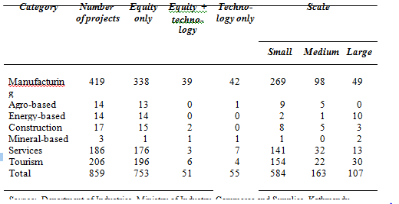
Number and category of projects
According to the statistics of the Department of Industries, a total of 859 projects with foreign collaboration (financial and technical) have been approved so far. The following table highlights the category, number, type of collaboration and scale of the projects.

Slide 35
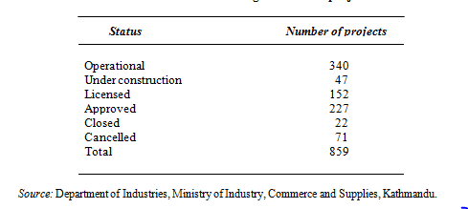
Operational status of the projects
Looking at the operational status, around 40 per cent of them are operational. The following table shows the latest status of foreign investment projects in Nepal.

Slide 36
Problems and issues of technology transfer in Nepalese small and medium enterprises
There are a number of problems that hinder technology transfer and development in Nepal.
Following are some of the major problems faced in the technology transfer.
Lack of technology assessment mechanism
the problems involved with technology transfer are not only related to the purchase of hardware or the contractual agreements for supply of technology, but are also linked to the country's existing socio-economic environment
social structure and organization appropriate to the level and characteristics of the technology used are also considered
no exception to the common characteristics of developing countries, where more attention is given to the hardware part than to the conditions required to ensure the efficient use of the technology
Insufficient attention to creating a favorable environment for technology transfer package as a whole often leads to failure of even the best transfer deals

Slide 37
Lack of technological infrastructure
there is a need for appropriate mechanism for technology adaptation, modification, innovation and absorption which, in the long run
do not have technology creation mechanisms due to limited resources
also necessary for the recipient country to create a favorable climate to facilitate an effective incorporation of the imported technology into the socio-economic environment of the country
Lack of technical manpower
lack of adequately trained manpower for operation and maintenance of imported machinery
Lack of clear provision for training of technical people of the industries from technology suppliers
dependency on foreign experts even to run and maintain the machinery, which is not affordable

Slide 38
Unavailability of spare parts
production operations are jeopardized because of delay in procuring spare parts of machinery imported from foreign countries
rapid obsolescence of the imported machinery further makes it increasingly difficult to obtain spare parts

Slide 39
Conclusion
By focusing on transfer of technology we do not want to give an impression that it is the only issue that matters. There are obviously other internal and external factors, which no doubt, have contributed towards the slow growth or even the decline of many LDCs.
However, SMEs play an important role in nation building in LDCs. By emphasizing technology transfer, we hope to draw attention to an issue, which we believe, is of serious importance, and also an issue which appears to have been ignored by the policy-makers of LDCs.

Slide 40
IT Policy in Nepal

Slide 41
INTRODUCTION
The world's least developed countries including Nepal have availed themselves of the opportunity to rapidly develop education, health, agriculture, tourism, trade and various other sectors using information technology (IT). In the coming years, globally, there will be a significant difference in the economic conditions of the countries developed in the field of information technology and of the countries lagging behind in this field. Hence, it has become essential to formulate a policy at the earliest for developing information technology with a view to boosting up national economy.

Slide 42
OBJECTIVES
The information technology policy shall be formulated to achieve the following objectives:
To make information technology accessible to the general public and increase employment through this means,
To build a knowledge-based society, and
To establish knowledge-based industries.

Slide 43
Strategies
The following information technology strategies shall be adopted to accomplish the mentioned objectives:
The government shall act as a promoter, facilitator and regulator.
High priority shall be accorded to research, development and extension of information technology with participation of private sectors
E-commerce shall be promoted with legal provisions..
IT shall be used to assist e-governance.
IT shall be applied for rural development.
IT industry shall be promoted.
Nepal shall be placed on the international market through information technology.
Computer education shall be incorporated in academic curriculum starting from the school level.

Slide 44
IT Policy in Nepal
The policies to be pursued for the implementation of the above-mentioned strategies shall be as follows:
To declare information technology sectors a prioritized sector.
To follow a single-door system for the development of information technology.
To establish a national level fund by mobilizing the resources obtained from His Majesty's Government, donor agencies, and private sectors so as to contribute to research and development of information technology and other activities pertaining to it.

Slide 45
Cont.
To provide internet facilities to all Village Development committees of the country in phases.
To render assistance to educational institutions and encourage native and foreign training as a necessity of fulfilling the requirement of qualified manpower in various fields pertaining to information technology.
To prioritize research and development of information technology.

Slide 46
Cont.
To establish National Information Technology Centre.
To establish venture capital funds with the joint participation of public and private sectors.
To include computer education in the curriculum from the school level and broaden its scope.
To establish Nepal in the global market through the use of information technology.
To draft necessary laws that provides legal sanctions to the use of information technology.
To computerize the records of each governmental office and build websites for them for the flow of information.
To increase the use of computers in the private sector.

Slide 47
NATURAL ENVIRONMENTAL ISSUES

Slide 48
Natural Environmental Issues
Pollution
Global Warming
Over Population
Climate Change
Loss of Biodiversity
Deforestation
Ocean Acidification
Ozone Layer Depletion

Slide 49
Pollution: Pollution of air, water and soil require millions of years to recoup. Industry and motor vehicle exhaust are the number one pollutants. Heavy metals, nitrates and plastic are toxins responsible for pollution.
Global Warming: Climate changes like global warming is the result of human practices like emission of Greenhouse gases. Global warming leads to rising temperatures of the oceans and the earth’ surface.

Slide 50
Overpopulation: The population of the planet is reaching unsustainable levels as it faces shortage of resources like water, fuel and food. Population explosion in less developed and developing countries is straining the already scarce resources.
Climate Change: Climate change is yet another environmental problem that has surfaced in last couple of decades. It occurs due to rise in global warming which occurs due to increase in temperature of atmosphere by burning of fossil fuels and release of harmful gases by industries.

Slide 51
Loss of Biodiversity: Human activity is leading to the extinction of species and habitats and loss of bio-diversity. Eco systems, which took millions of years to perfect, are in danger when any species population is decimating.
Deforestation: Our forests are natural sinks of carbon dioxide and produce fresh oxygen as well as helps in regulating temperature and rainfall. Deforestation simply means clearing of green cover and make that land available for residential, industrial or commercial purpose.

Slide 52
Ocean Acidification: It is a direct impact of excessive production of CO2. 25% of CO2 produced by humans.
Ozone Layer Depletion: The ozone layer is an invisible layer of protection around the planet that protects us from the sun’s harmful rays. Depletion of the crucial Ozone layer of the atmosphere is attributed to pollution caused by Chlorine and Bromide found in Chloro-floro carbons (CFC’s).

Slide 53

Energy Situation in Nepal

Slide 54
Introduction
Most important resource for economic and social development
Used to determine the development of trade and industry of a country
Condition of Nepal is not satisfactory
Traditional source have dominance over energy demand and consumption
Energy crisis has continued to grow as a result of failure to achieve notable progress in the production of alternative energy

Slide 55
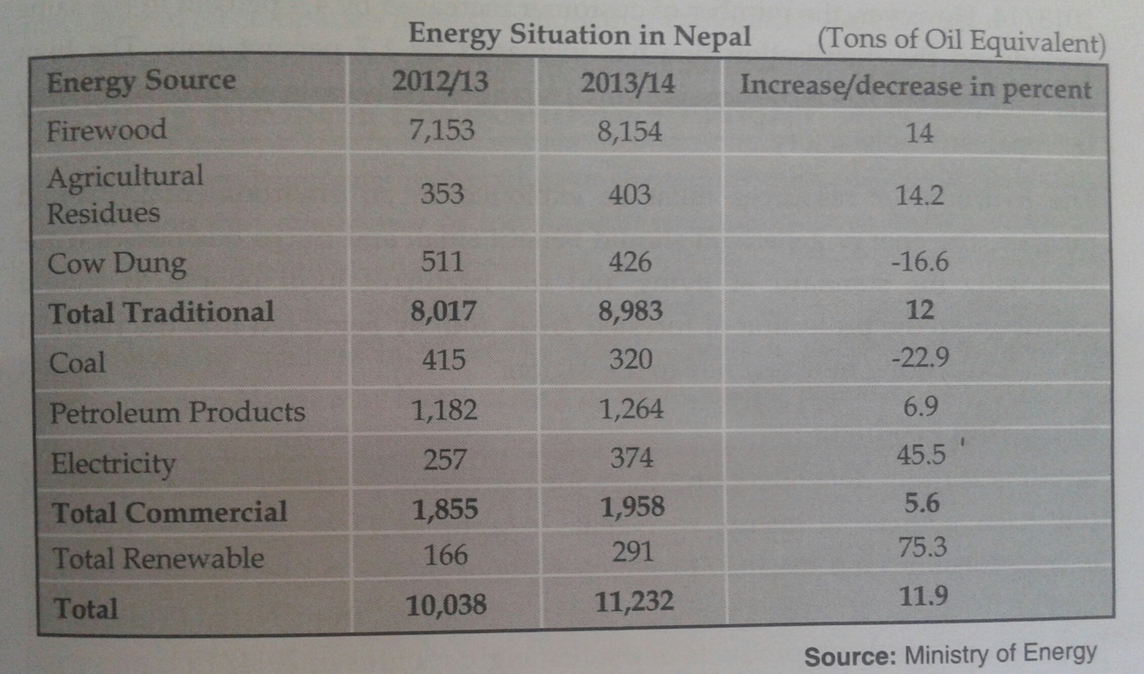
Source of energy and their consumption status of last two years

Slide 56

Electricity
Nepal is rich in water resource with the capability of generating 40,000MV of electricity
However less than 2% of this has been generated
Hydro-electricity could be the backbone of Nepalese economy if exploited properly

Slide 57
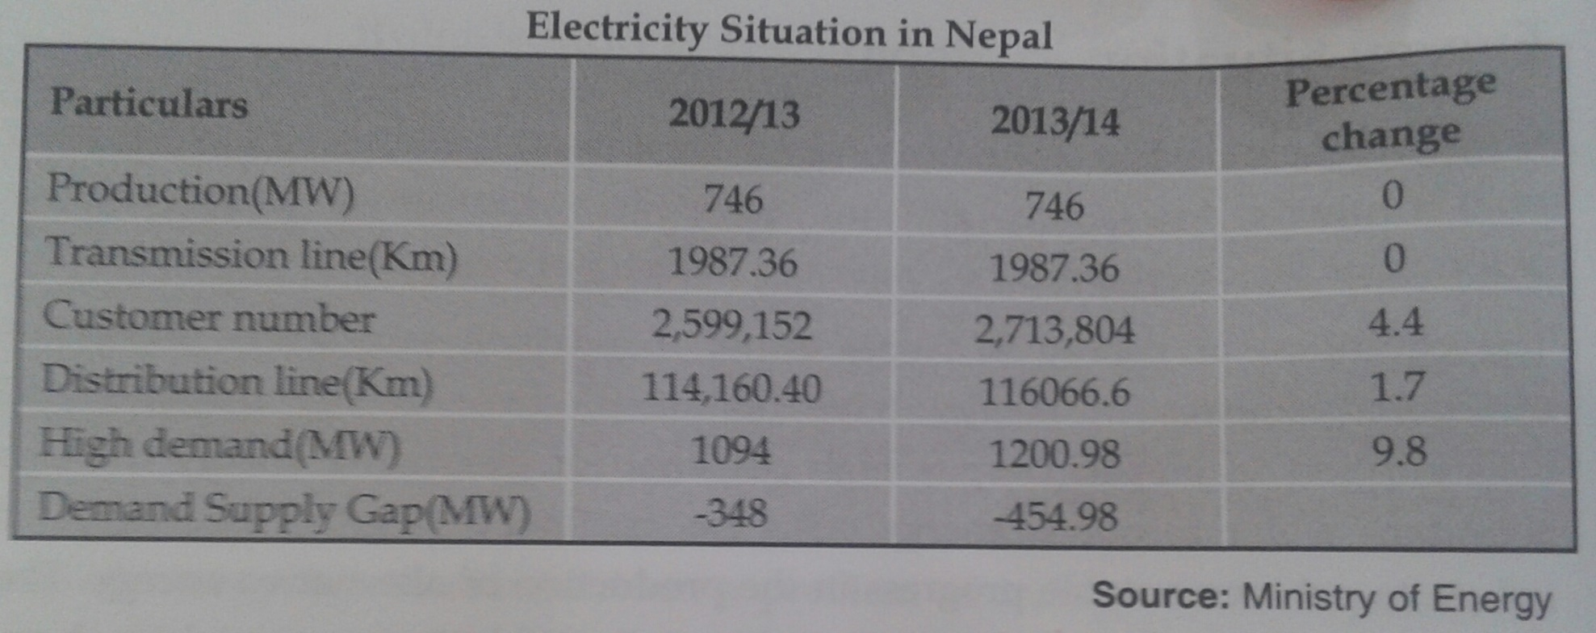
Electricity situation in Nepal

Slide 58

Petroleum Products
Nepal is entirely dependent on others for petroleum products
Occupies 11.25% of total energy consumption in 2013/14 which is more than previous year
Is the major source of foreign currency outflow
Imports of petroleum products have been the high reason for high trade deficit
Traces of oil and natural gas have been found in different parts of the country

Slide 59
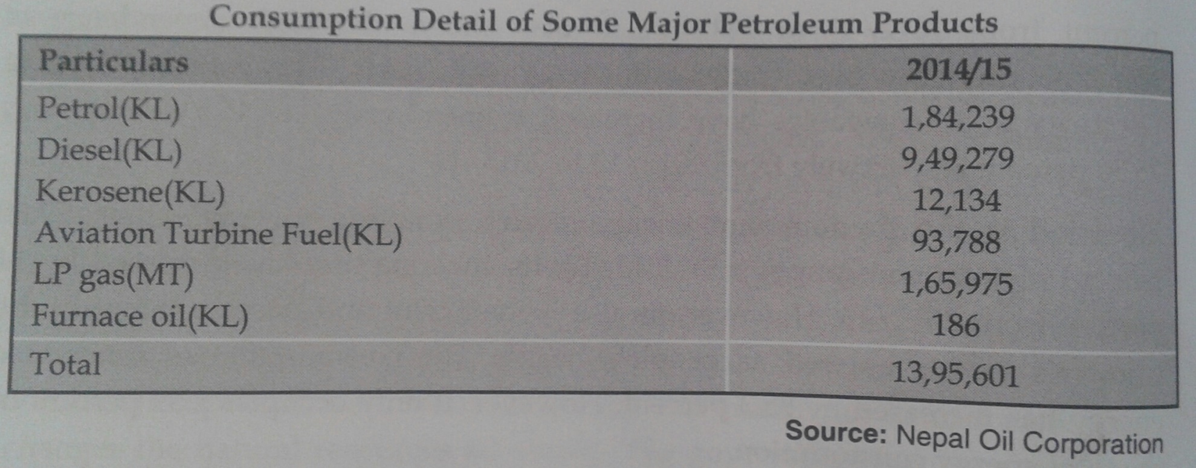
Consumption Details of Some major Petroleum Products

Slide 60
Environment and Energy Management issues in Nepal

Slide 61
Introduction
The 20th century had seen significant advances in energy
generation, delivery and utilization, but has also
produced tremendous impact on the environment and
natural resources.
• Significant changes must be made to how we generate,
deliver and use energy so as to
– establish sustainable utilization
– restore environmental balance.

Slide 62
Needs of 21st century
Increase renewable generation
– 7% of today’s energy supply comes from renewable sources (hydroelectric, wind, solar, biomass).
– Renewable generation must increase significantly but responsibly.

Slide 63
• Increase nuclear generation suitably
– 8% of today’s energy supply comes from nuclear power
– Nuclear generation must increase so that there is adequate supply from steady sources.

Slide 64
Sustainable utilization of resources
• Technological enablers
– Energy efficient buildings with thermal storage
– “Smart” homes and “smart” appliances
– Demand response and load management programs
– Energy efficient transportation: hybrid and electric vehicles
– Storage and direct conversion technologies
• Growing need for conservation
• Demand profiles will change significantly
– Composition of load is changing
– Load factor is likely to change too

Slide 65
Forms of renewable energy resources
Wind turbines and wind farms,
Solar photovoltaic (PV) cells,
Solar-thermal energy,
Fuel Cells
Geothermal
Wave and tidal energy
Biomass
Micro or mini hydro

Slide 66
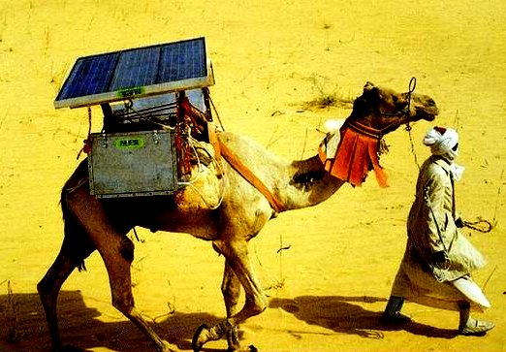
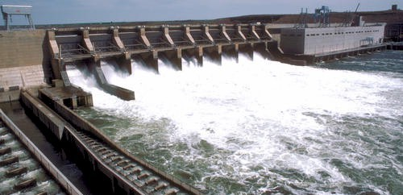

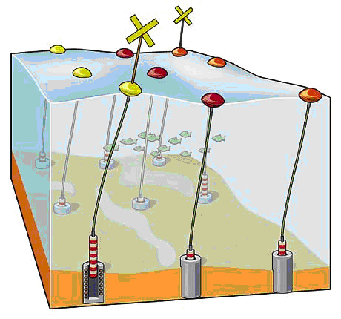
SOLAR REFRIGERATION
HYDROPOWER
WAVE ENERGY
BIOMASS
Fig 1

Slide 67
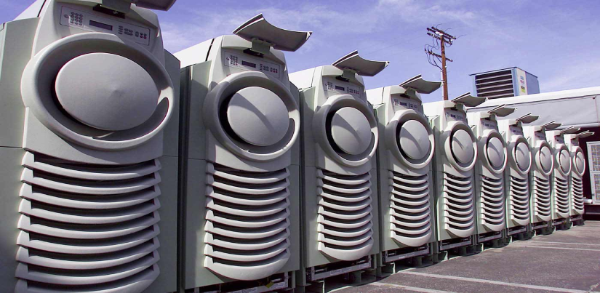
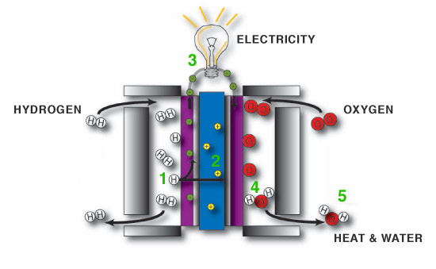
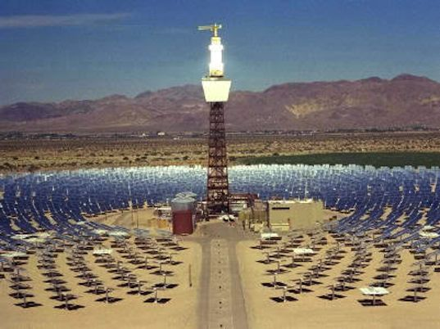


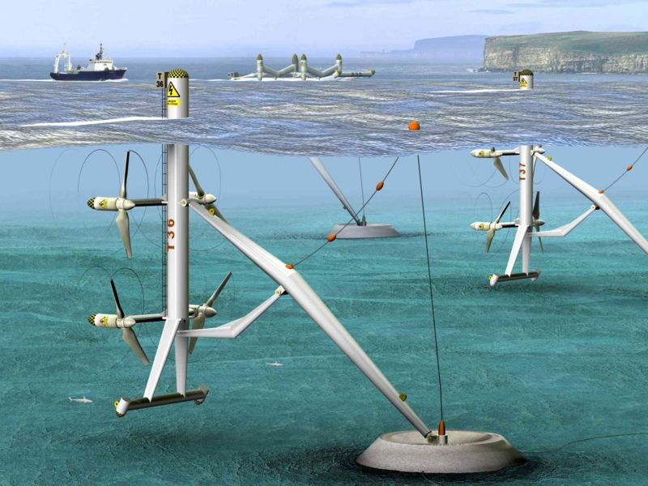
MICROTURBINE
FUEL CELL
SOLAR THERMAL
PHOTOVOLTAIC
GEOTHERMAL
TIDAL POWER
Fig 2

Slide 68
Energy Management
Reduced profits due to high production cost.
Decline of sales energy-using products.
Loss of competitiveness in energy intensive business.
Disruptions in supply chains as suppliers are unable to meet the cost obligations.

Slide 69
Issues relates with energy management.
Nepal has the critical shortage of energy.
Industrial and commercial consumers pay electricity and petroleum product prices that are among highest in the world.
System loss occurs mostly due to theft of electricity by unauthorized connections and unpaid bills.
The subsidy policy is based on “bigger the better” and “more the merrier” philosophy.
Government delays on resourses mobilization.

Slide 70
Issues relates with energy management. Cont…
Political interference and corruption in private investment and in bureaucracy have more aggravated problem.
Since many project were selected on the political injustice, it failed to implement its holistic approach leaving the micro hydro projects vulnerable.
The other issues of energy supply is its mismanagement. NEA has one of the lowest self-finance ratio and net returns on investment.

Slide 71


